Slide 1
Bring Order to Chaos: Fuzzy Matching for Business Data
Team 22: Ronglu Jiang, Yongze Jiang, Xinyi Wen, Wanghao Ying, Yifan Zhang

Slide 2
01
Exploratory Data Analysis
& Visualization
Notes:
To take a first look of both data, we did EDA.

Slide 3
Explore the Data
01
02
03
04
05
06
df.shape
df.dtypes
df.head()
Left data have 98509 rows and right data have 94585 rows.
Left data have zip code as object and right data have postal code as float64.
Exam both data frame.
State Distribution
City Distribution
Zip Code Distribution by States
With pie chart visualization, they have similar distribution.
With pie chart visualization, they have similar distribution.
Notes:
We first take a look at the shape and data types of both df. And used head to take a first look. Then, we visualize the distribution of the components in the df: states, city, and zip code

Slide 4
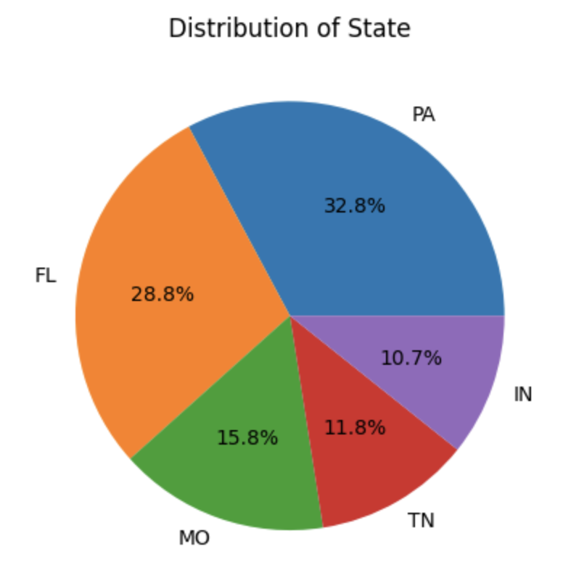
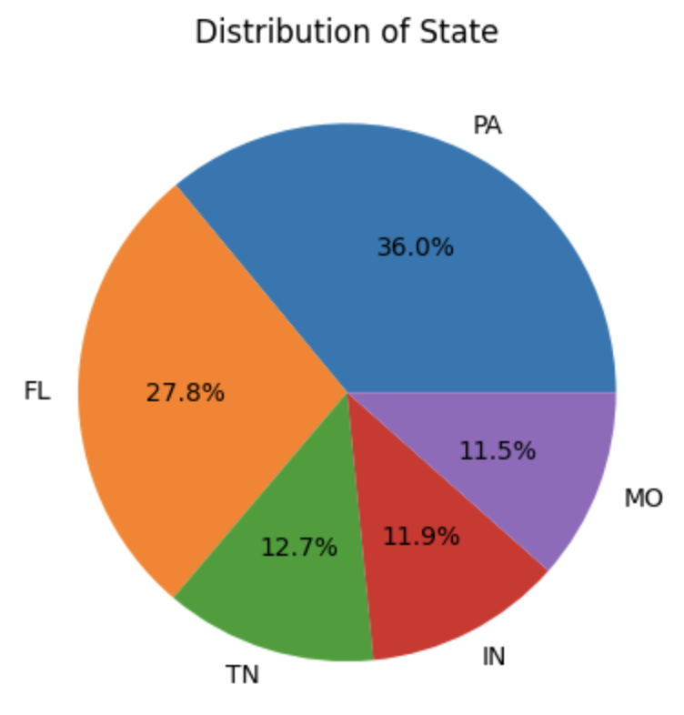
State Distribution
Left
Right
Notes:
We can see that the distribution of states of PA,FL,MO,TN, IN are almost same.

Slide 5
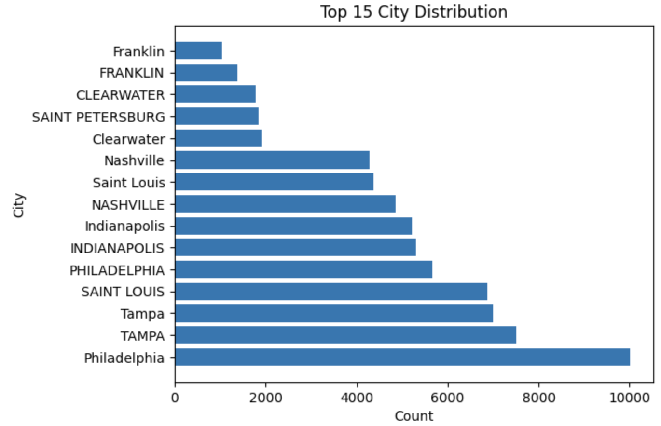
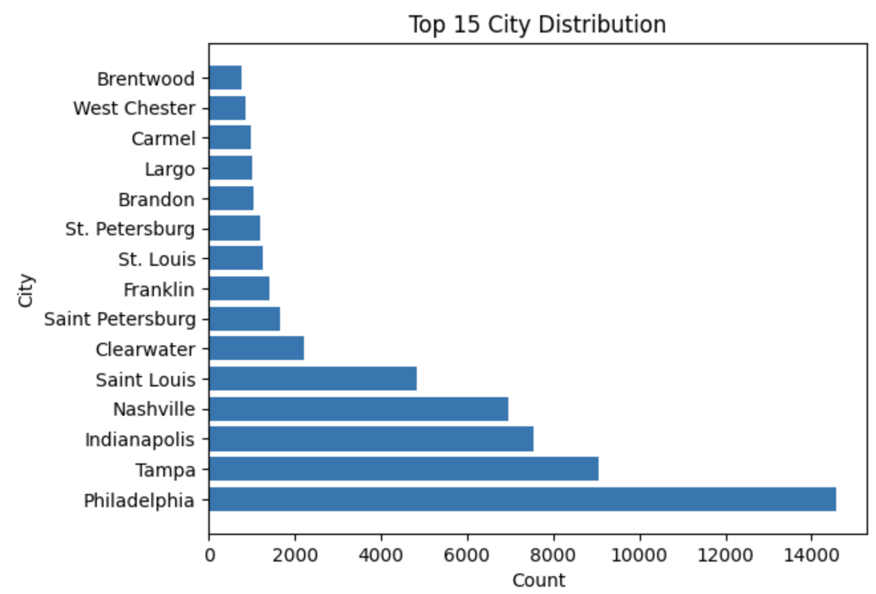
Top 15 City Distribution
Left
Right
Notes:
We can see there are duplicate city before cleaning, such as with different case of Philadelphia, tampa and saint louis. So we need to further clean the data.

Slide 6
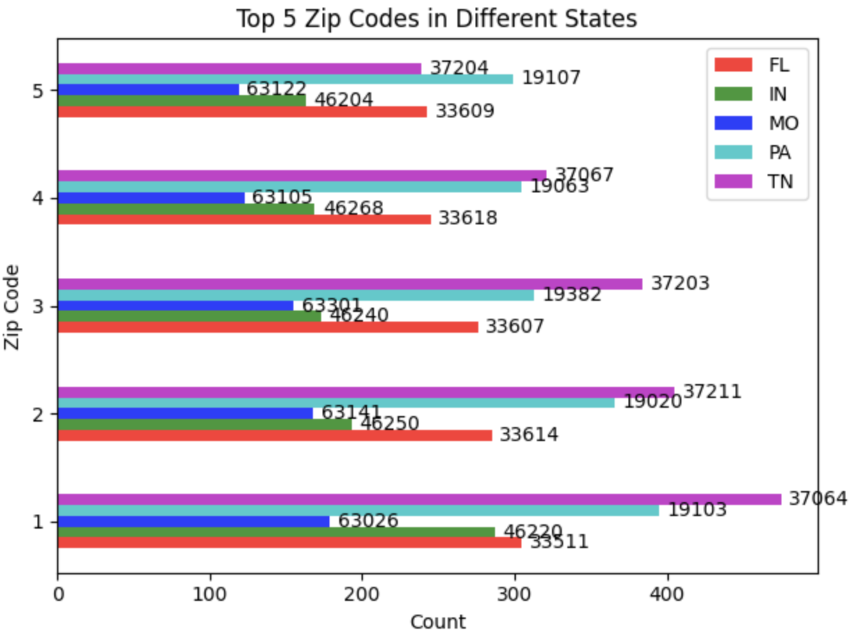
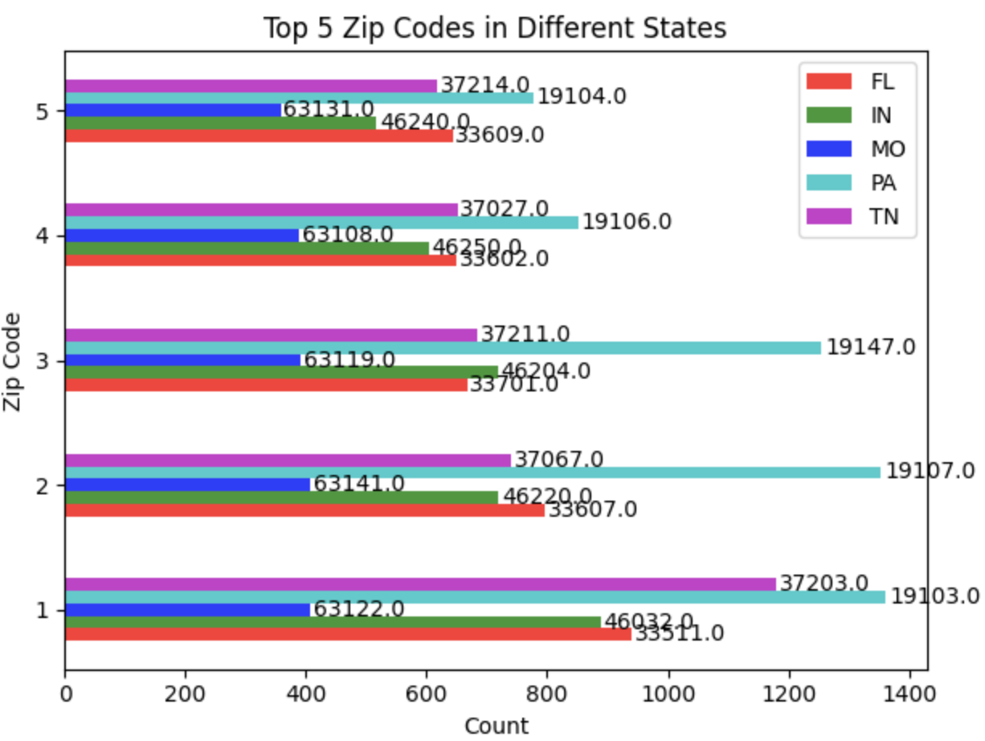
Top 15 City Distribution
Left
Right
Notes:
We can see that the zip code data type is different and the top zip codes are mostly different too. We need data cleaning to make further investigate. However, it gives us an idea to use zip codes and postal codes as the cut-in point during matching.

Slide 7
02
Data Preprocessing
Data Cleaning & Standardization

Slide 8

Data manipulation processes
1: data standardization
2: abbreviations to full name
3: deal with city data entry inconsistencies

Slide 9
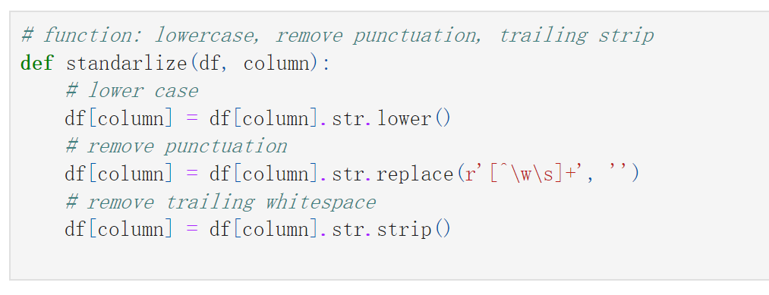
Data Standardization
For this step, we do the all characters lowercase process,
removing punctuations and removing trailing white spaces
[ we did this process for name, address and city columns]

Slide 10
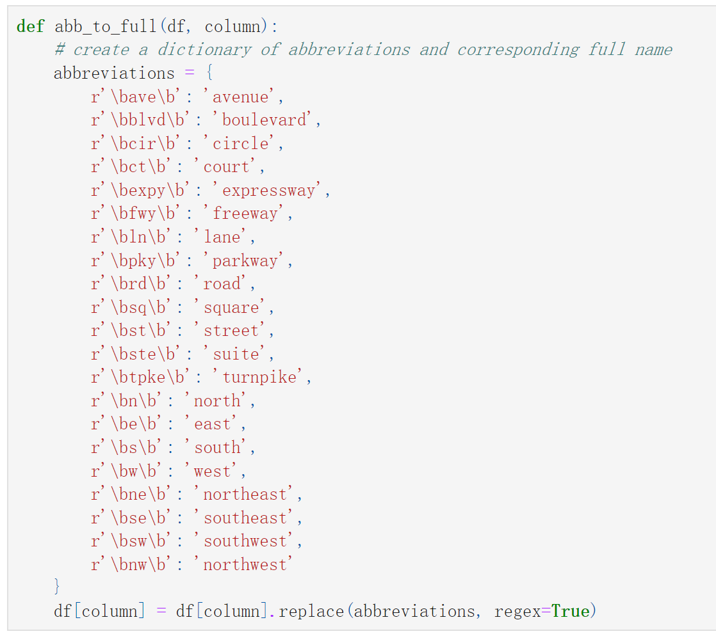
Replace abbreviations in address to full names
For this step, we define a function that with a dictionary of abbreviations, to convert the all the abbreviated words into full expressions

Slide 11
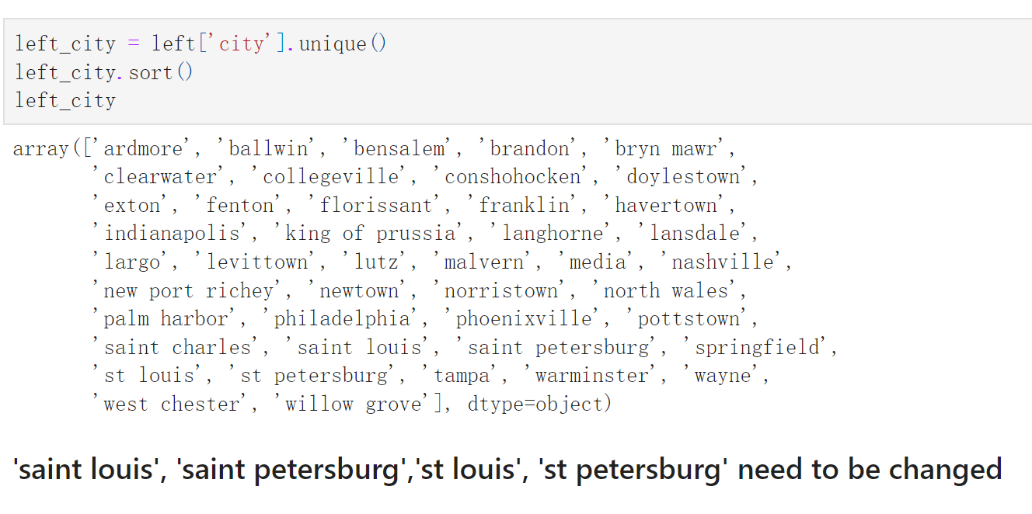
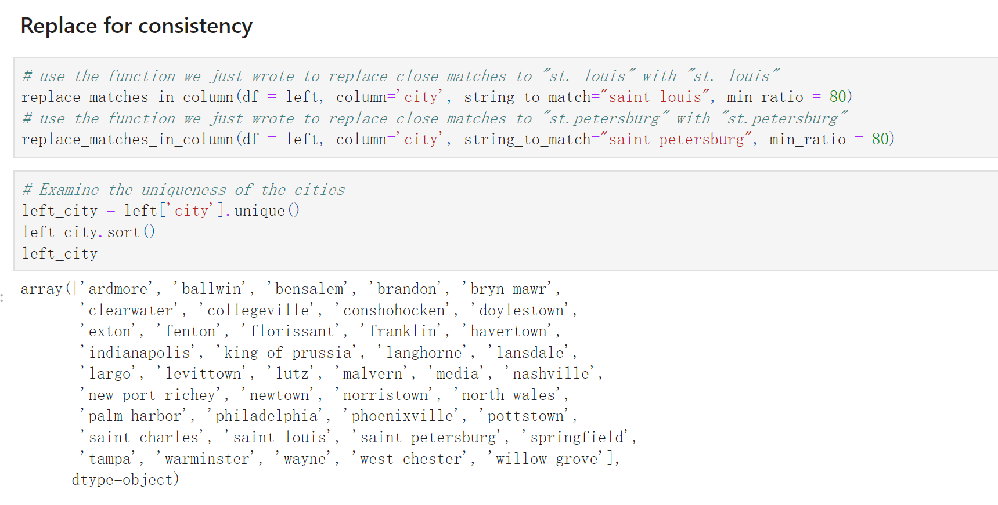
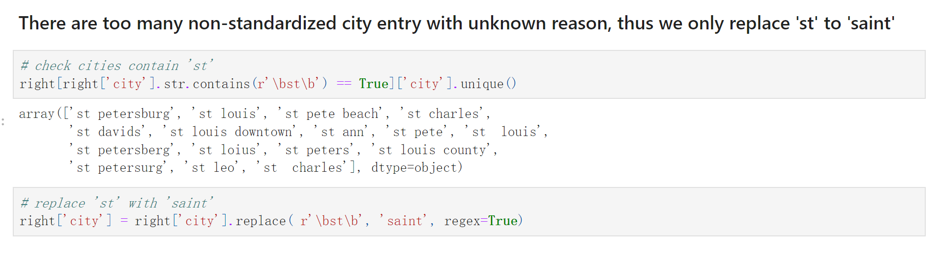
Data Entry Inconsistencies
Firstly, we determine the unique name of the city in dataset, and we found out that 'st louis', 'st petersburg' need to be changed;
After our process, we replace for consistency of city columns for saint louis and saint petersburg with minimum ratio of 80;
But there are still too much non standardized city data, so we only replace st to saint

Slide 12
03
Fuzzy Matching

Slide 13
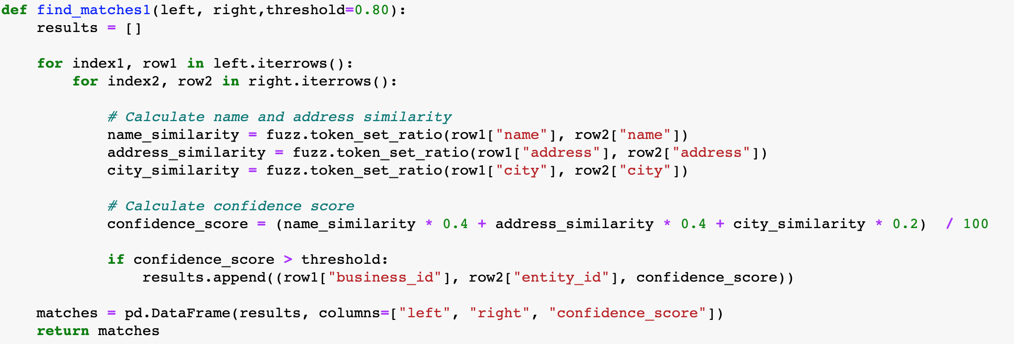
The "find_matches1" function helps identify potential matches between records from two dataframes using fuzzy string matching. It considers name, address and city attributes to compute similarity scores and determine if records match based on a confidence score.

Slide 14
Function Running Logic
Iterating through rows: The function compares each record from the left dataframe with every record in the right dataframe to identify potential matches.
Calculating similarity scores: FuzzyWuzzy's "token_set_ratio" method is used to calculate similarity scores for name, address and city fields.
Computing confidence scores: A weighted average of similarity scores produces a confidence score for each record pair. If the confidence score is above a specified threshold, the pair is considered a match and added to the results list.

Slide 15
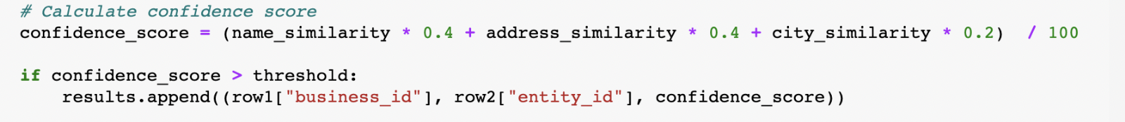
Confidence Score Calculation and Weights
Name and address similarities play a significant role in accurately identifying matches, which is why they are assigned higher weights in the confidence score calculation.
City, on the other hand, act as supportive criteria in the matching process. It cover broader ranges and are given lower weights to ensure that the matching algorithm effectively screens and identifies the most accurate matches.

Slide 16
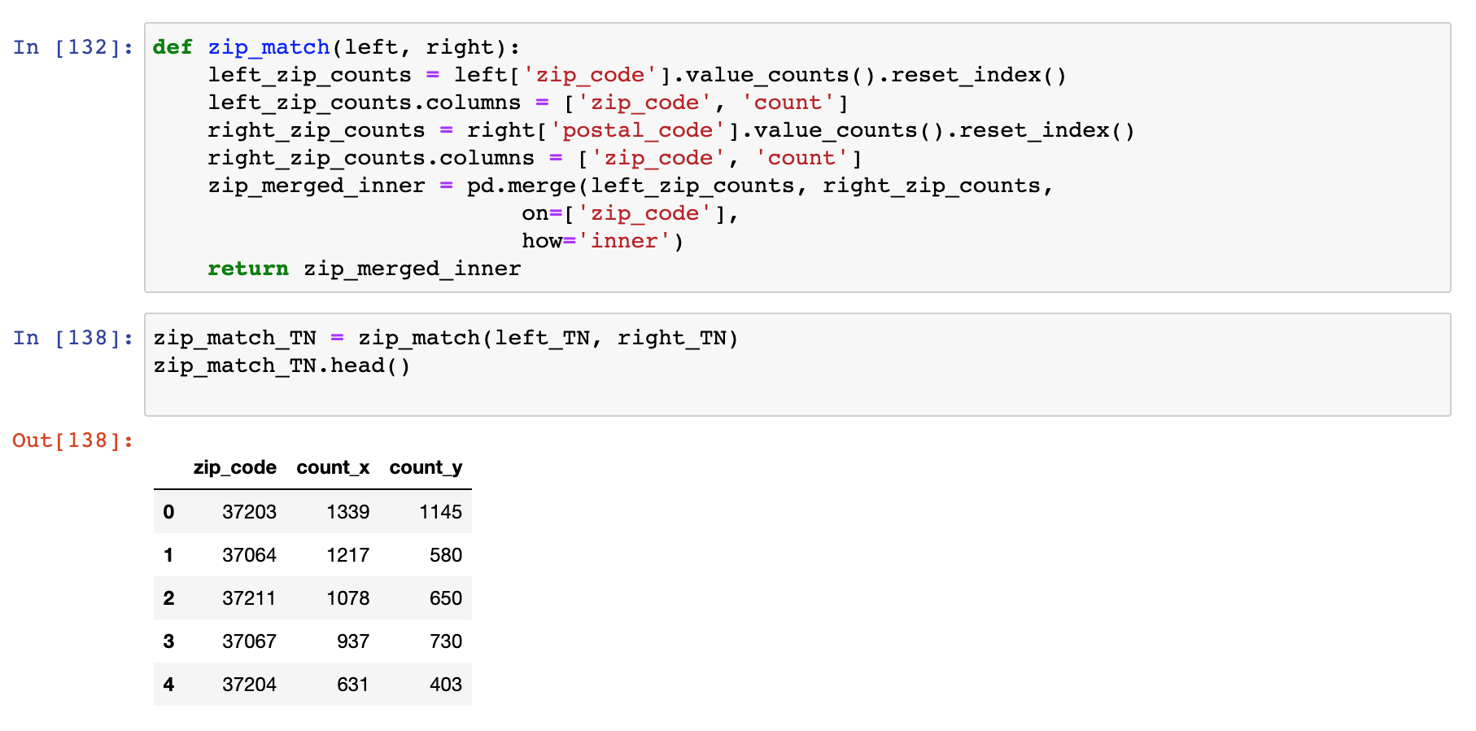
Match by State & Zip Code
Divide left and right datasets by state
Within a state, get common zip codes of the left and right dataset and number of counts

Slide 17
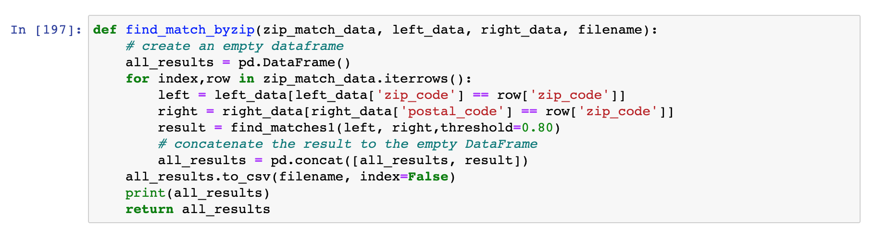
Match by State & Zip Code
Conduct fuzzy matching between each pair of left & right subsets with the same zip code to reduce execution time
Concatenate matching results to one data frame and save as a csv file

Slide 18
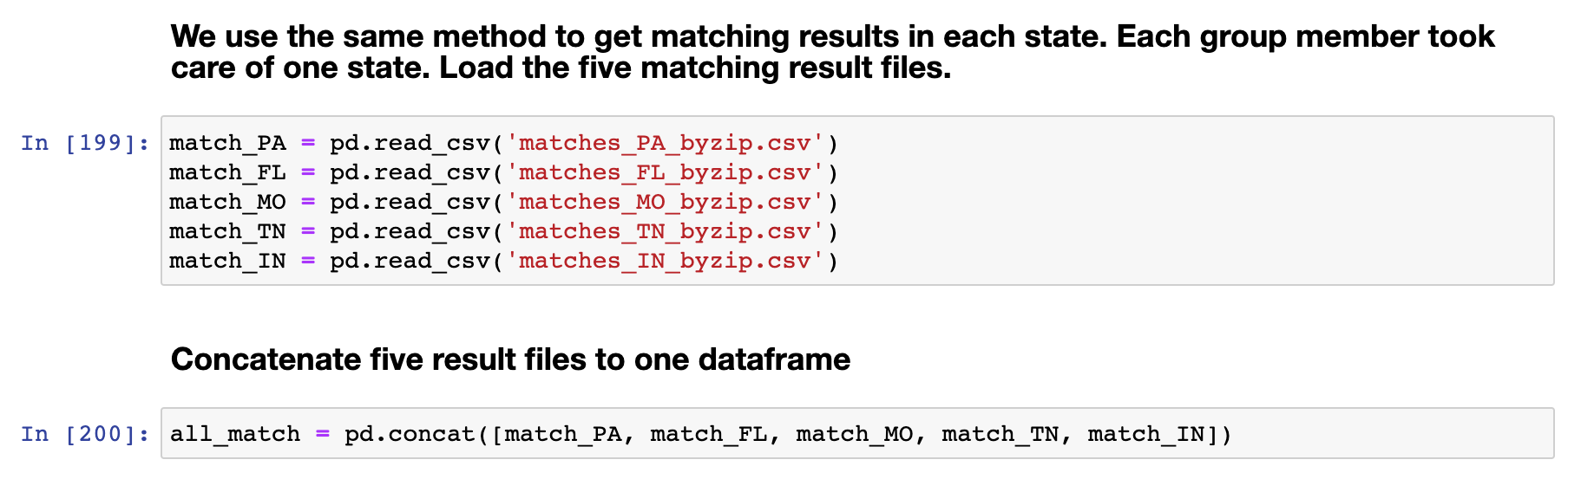
Match by State & Zip Code
Apply this function on each state-subset and concatenate the five result files to get the final matching results

Slide 19
04
Results

Slide 20
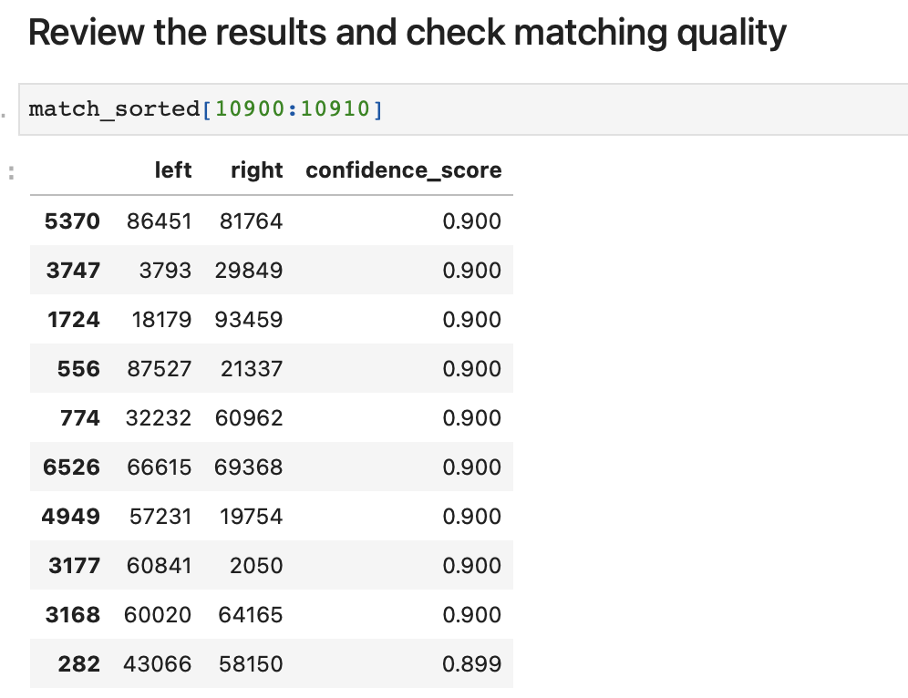
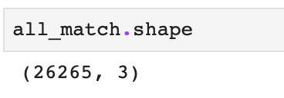
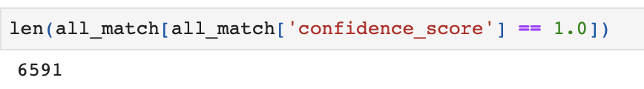
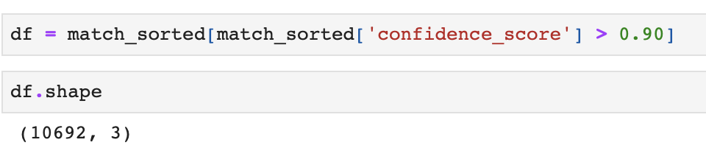
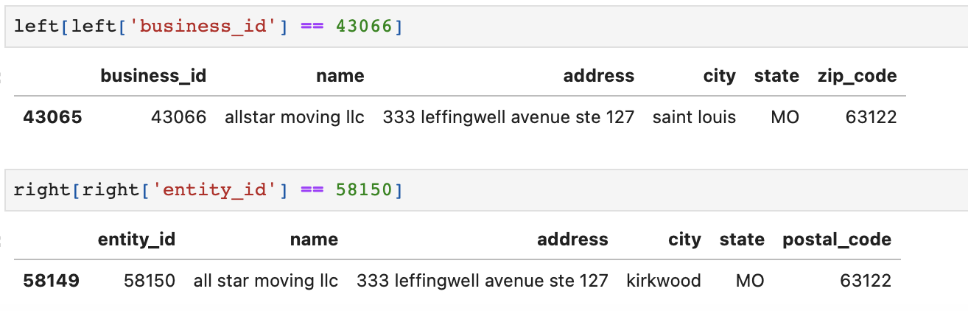
Examine all matching results
Number of exact matching
Final results with threshold = 0.9

Slide 21
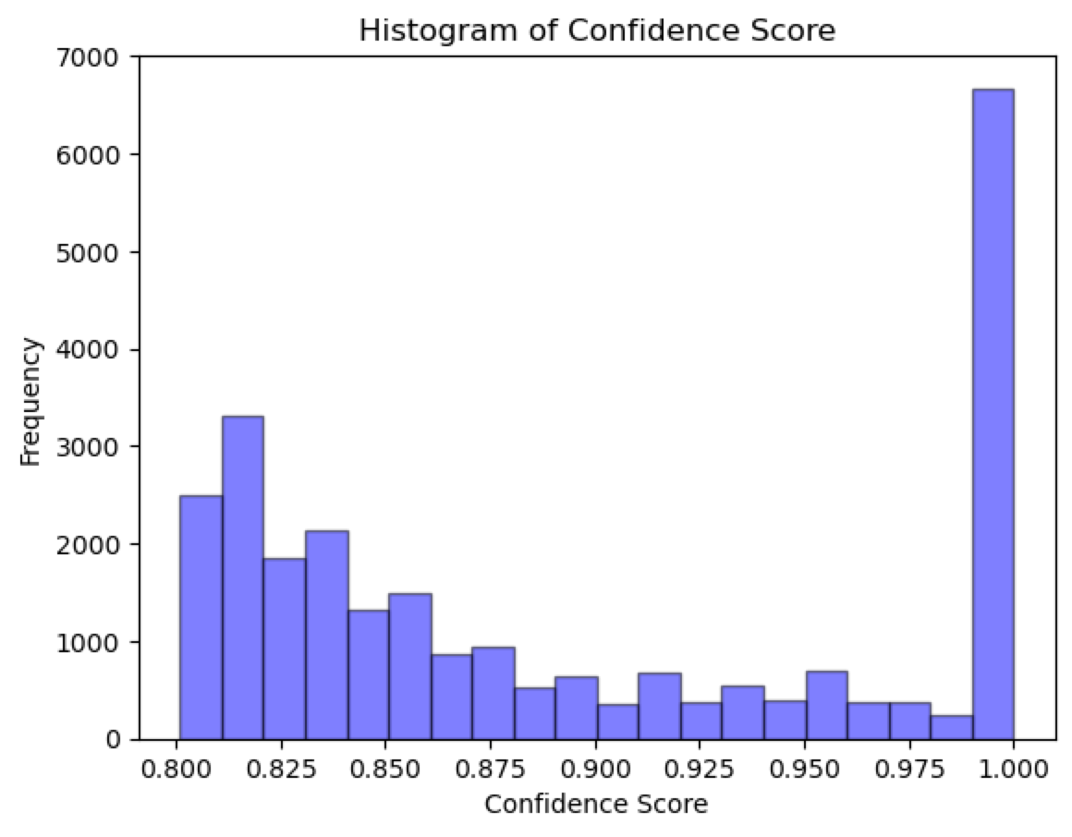
Visualize matching results
Choose confidence score = 0.90 as a threshold for acceptable matchings

Slide 22
Github Links
Yifan Zhang (yz4388): https://github.com/YifanZhang0522/5210.git
Wanghao Ying (wy2416):

Slide 23
Thanks!

